Slide 1
정합 예상 결과

Slide 2
Experimental Results
환자번호: 2746915803
Clinical Remarks:
"좌측 폐/ 커지고 명확해짐
1번 폴더 35-36 (IM 35-36)
2번 폴더 37-40 (IM 37-40)"

Slide 3
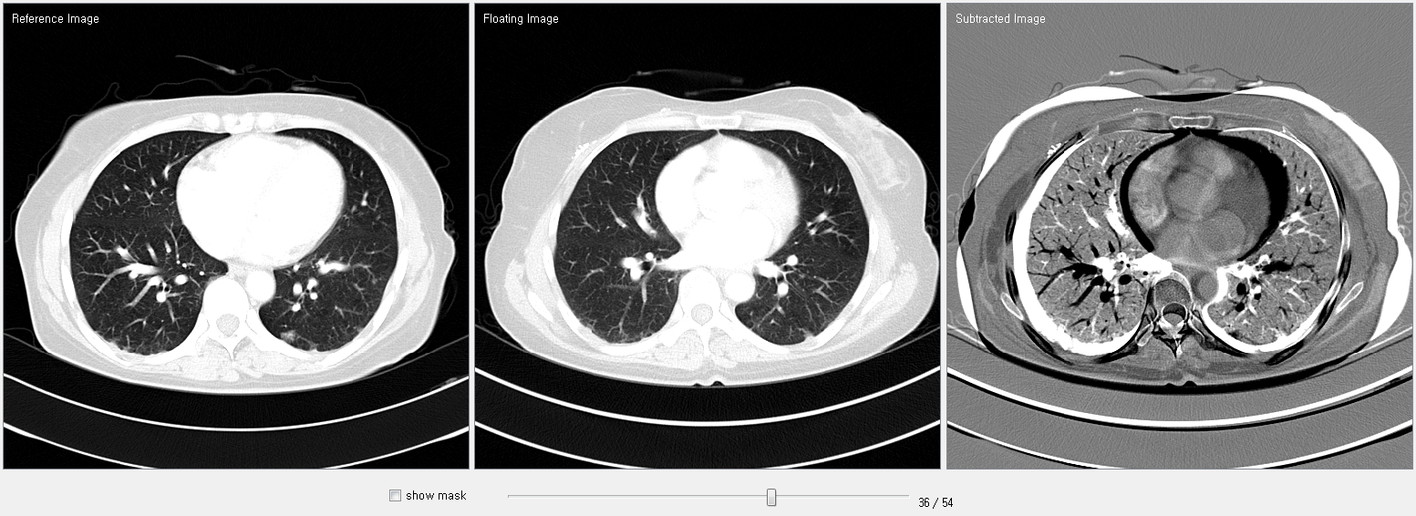
Experimental Results
Before Registration (slice #: 36)
Subtraction
before REG
Reference
Float

Slide 4
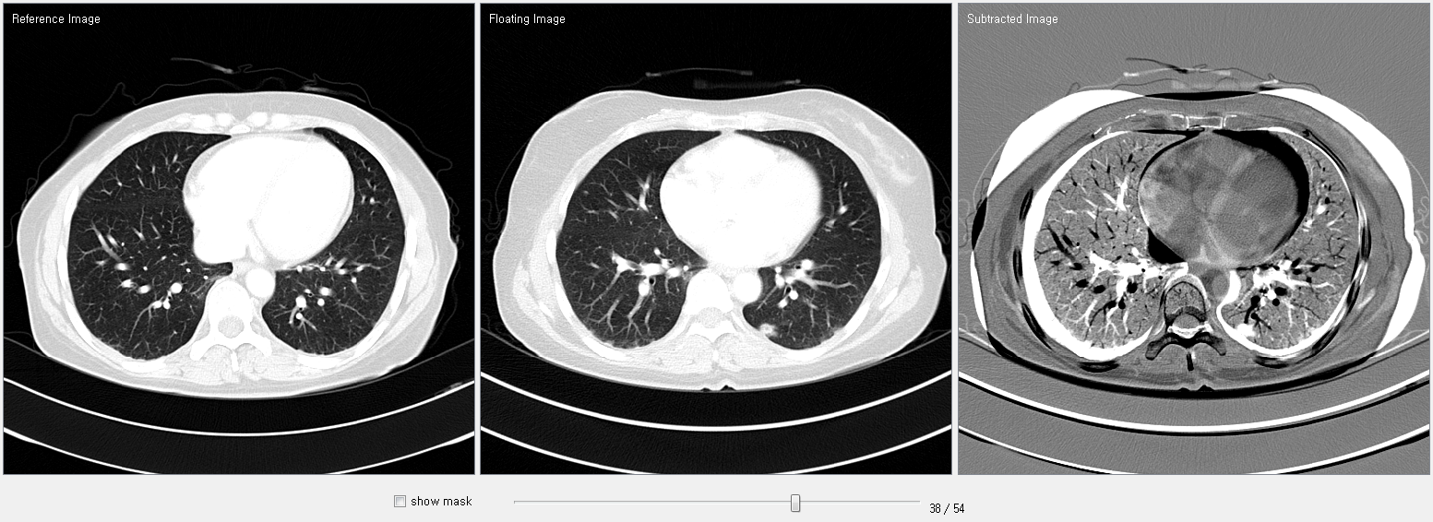
Experimental Results
Before Registration (slice #: 38)
Subtraction
before REG
Reference
Float

Slide 5
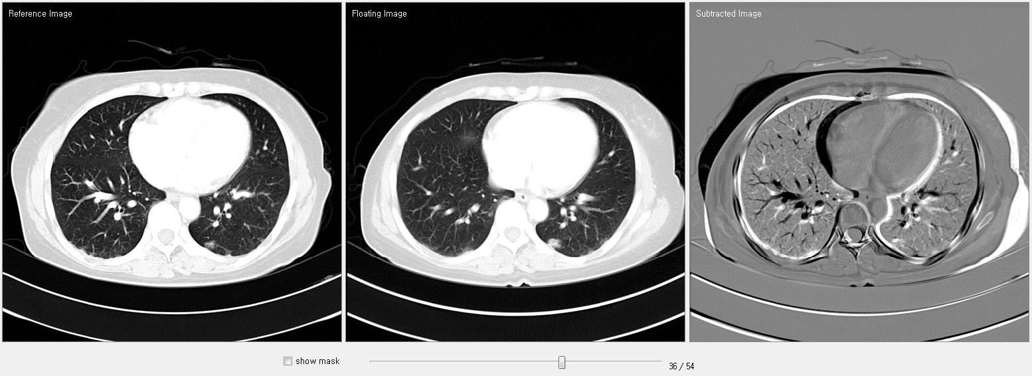
Experimental Results
After Registration (slice #: 36)
Subtraction
after REG
Reference
Float

Slide 6
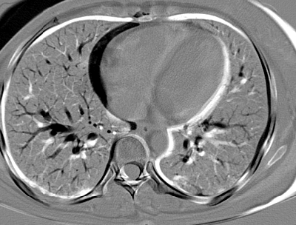
Experimental Results
After Registration (slice #: 36) with Zoom

